Slide 1
AME20216 - Lab I L9 – Solar Power

Slide 2
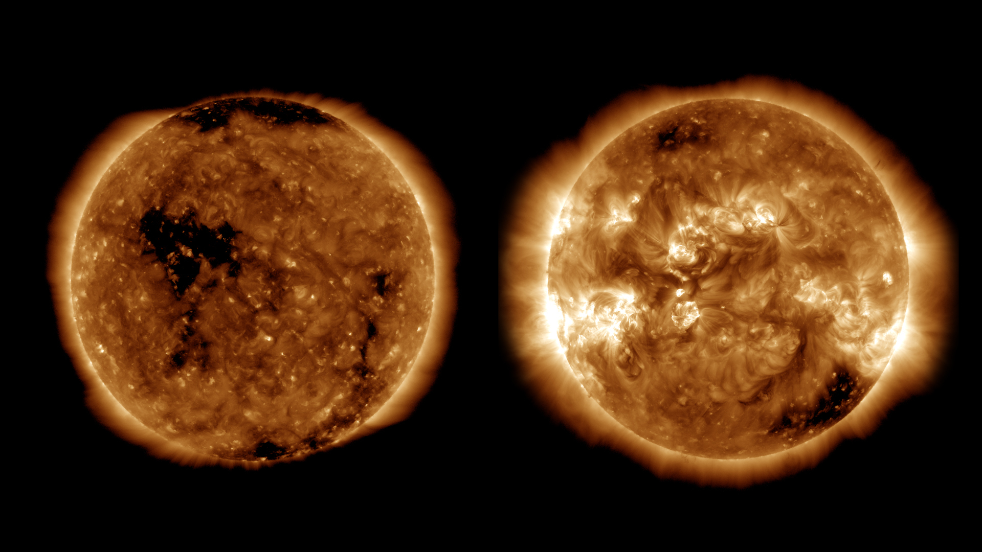
The Sun
4.6 Billion yrs old, mass 2x10³⁰ kg, diameter 1.4x10⁹ m, temperature 5250K, power 3.8x10²⁶ W

Slide 3
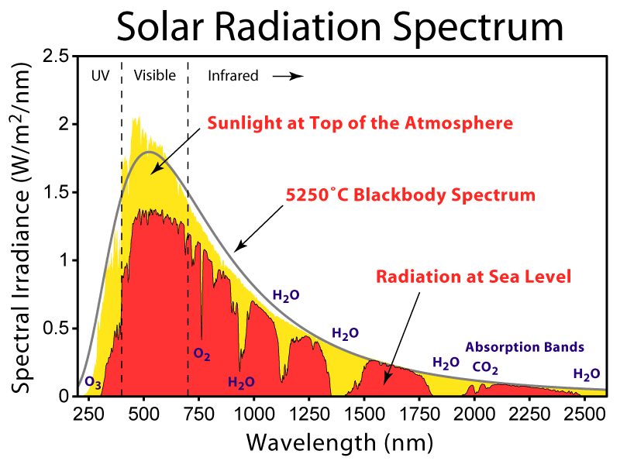

Slide 4
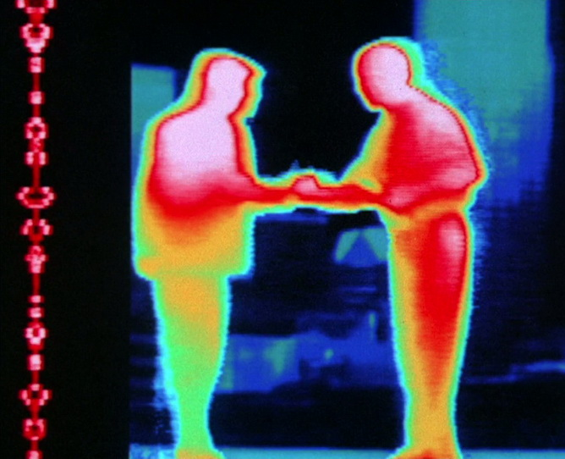
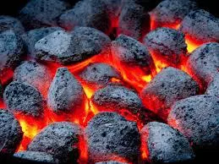
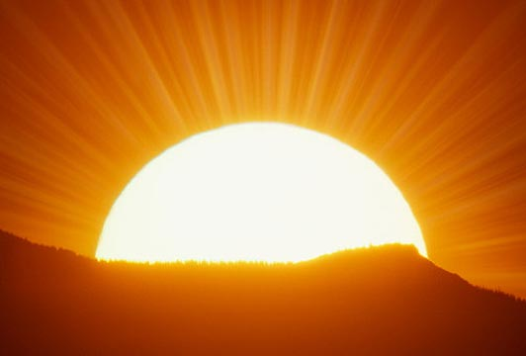
Black Body Radiation
Warm objects emit “black body radiation”.
T~300K Infrared
T~1000K Red
>5000K “White hot”
Omega.com

Slide 5
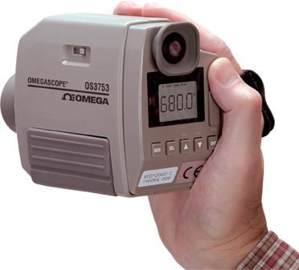
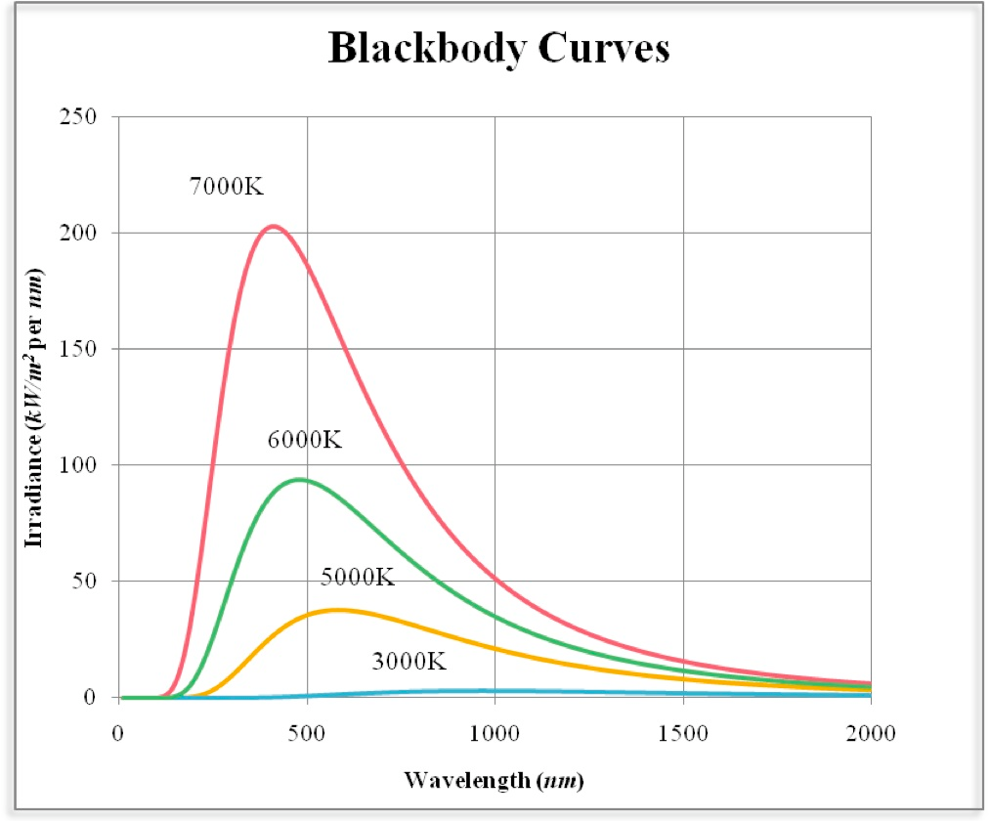
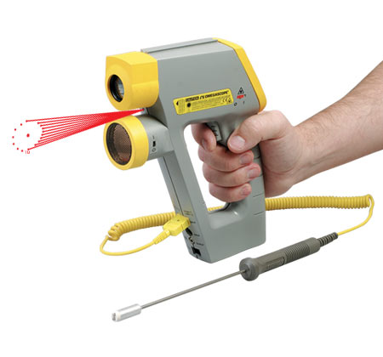
Pyrometer
Determines temperature from infrared blackbody radiation
Useful for non-contact, high-temeprature measurements
Omega.com

Slide 6
Irradiance of a Star
Stefan-Boltzman Law
Irradiance vs. temperature
on the surface of a star
T = 5250 K for our sun
Inverse Square Law
Irradiance vs. distance
from a star
P₀ = 3.8x10²⁶ W for our sun

Slide 7
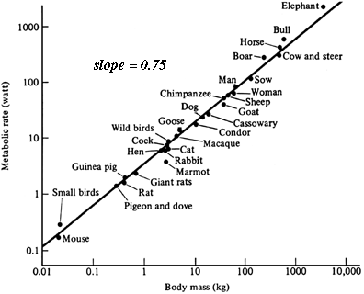
Power Law Scaling
Kleiber’s Law
Metabolic rate vs. mass
http://eesc.columbia.edu/courses/ees/life/lectures/lect03.html

Slide 8
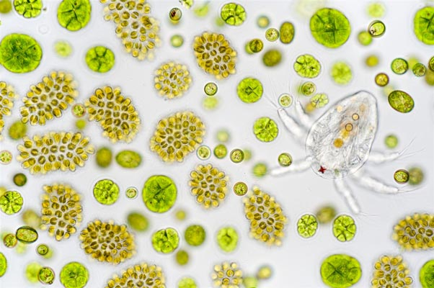
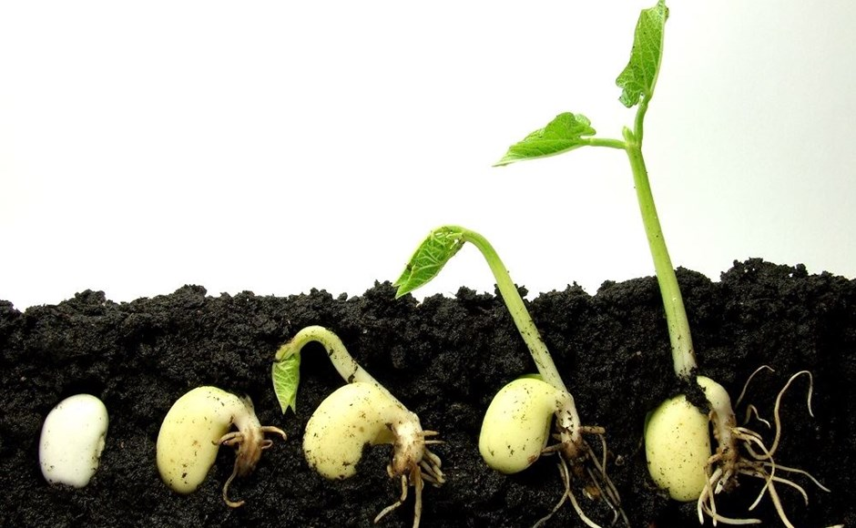
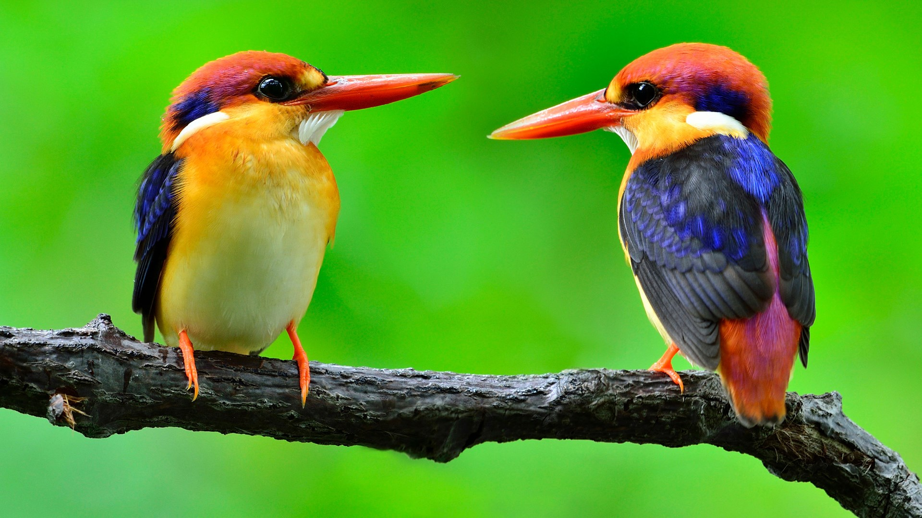
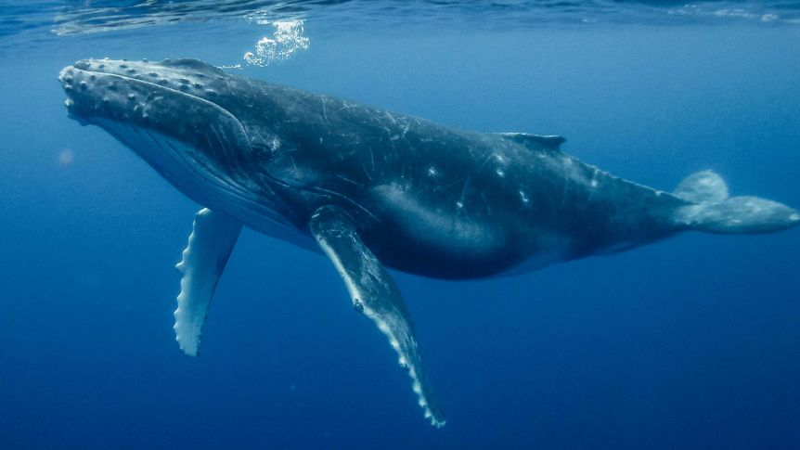

Slide 9
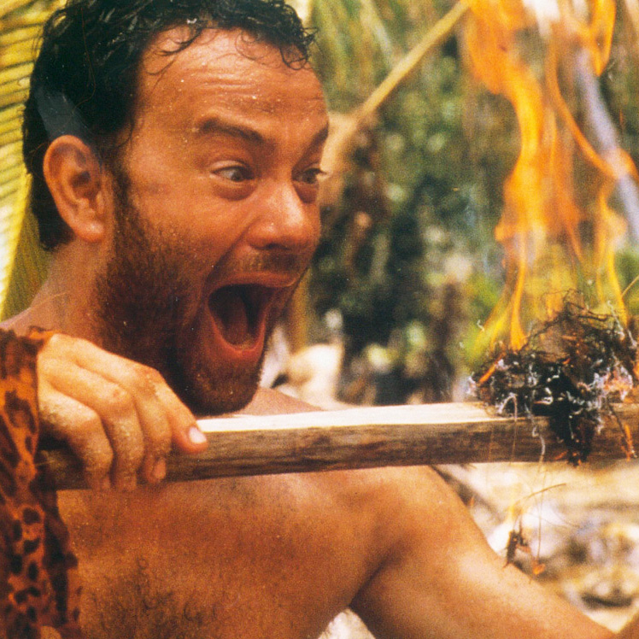
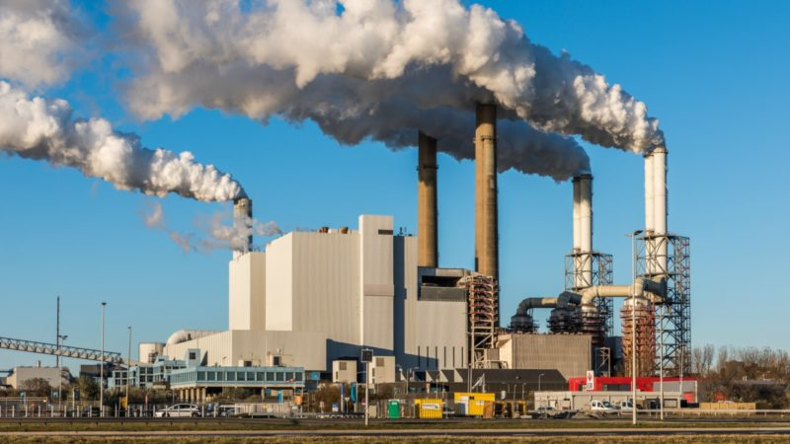
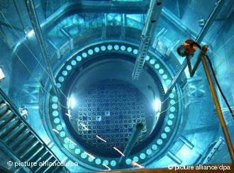
Energy Consumption
Human metabolism ~ 100W
Human “social metabolism” ~ 10,000W

Slide 10
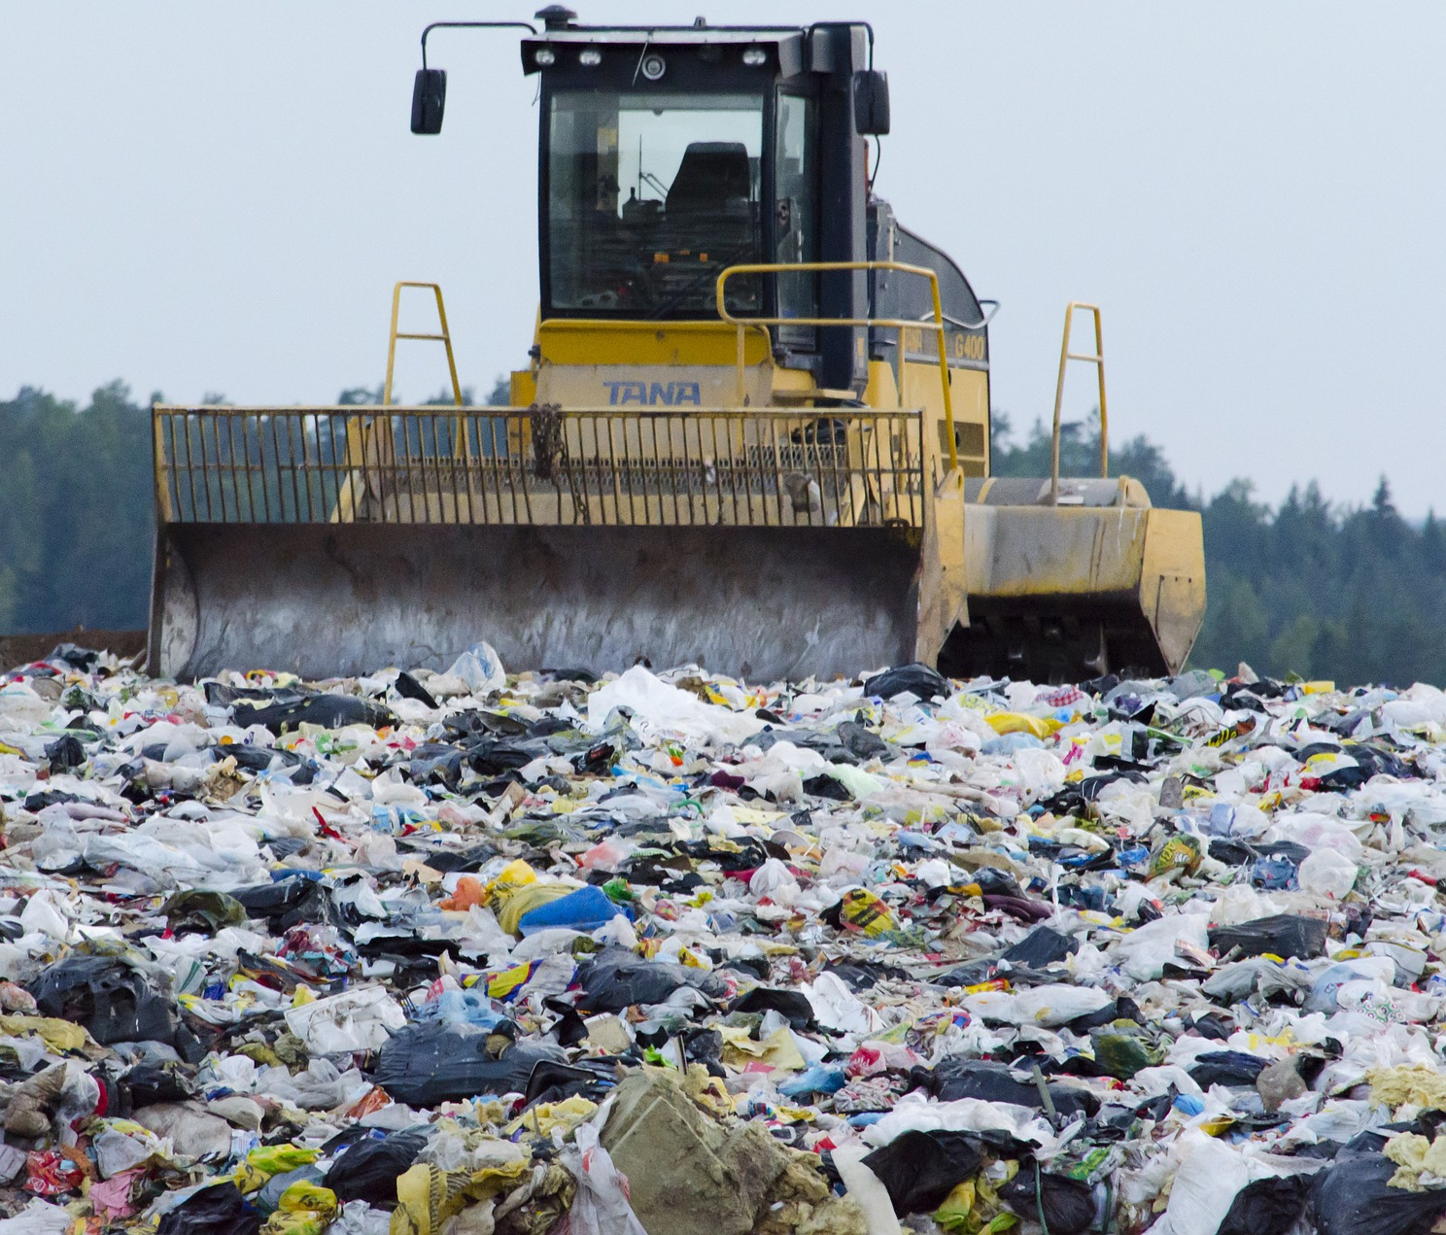
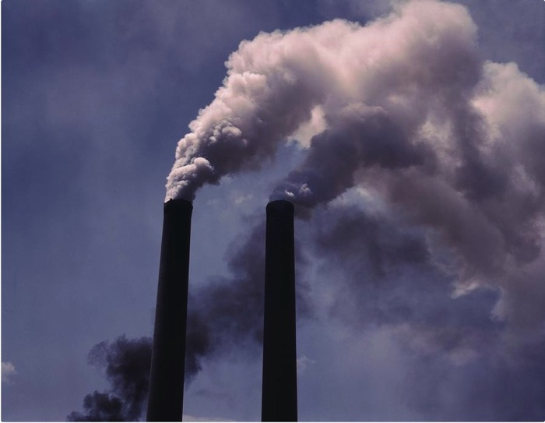
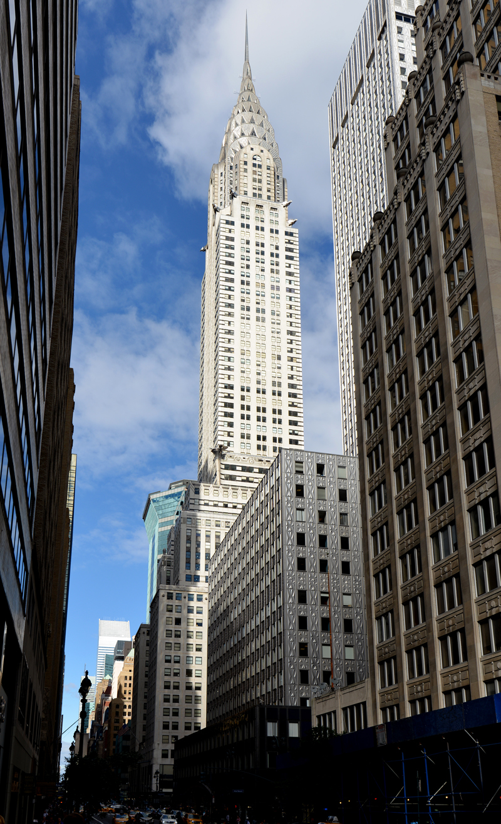
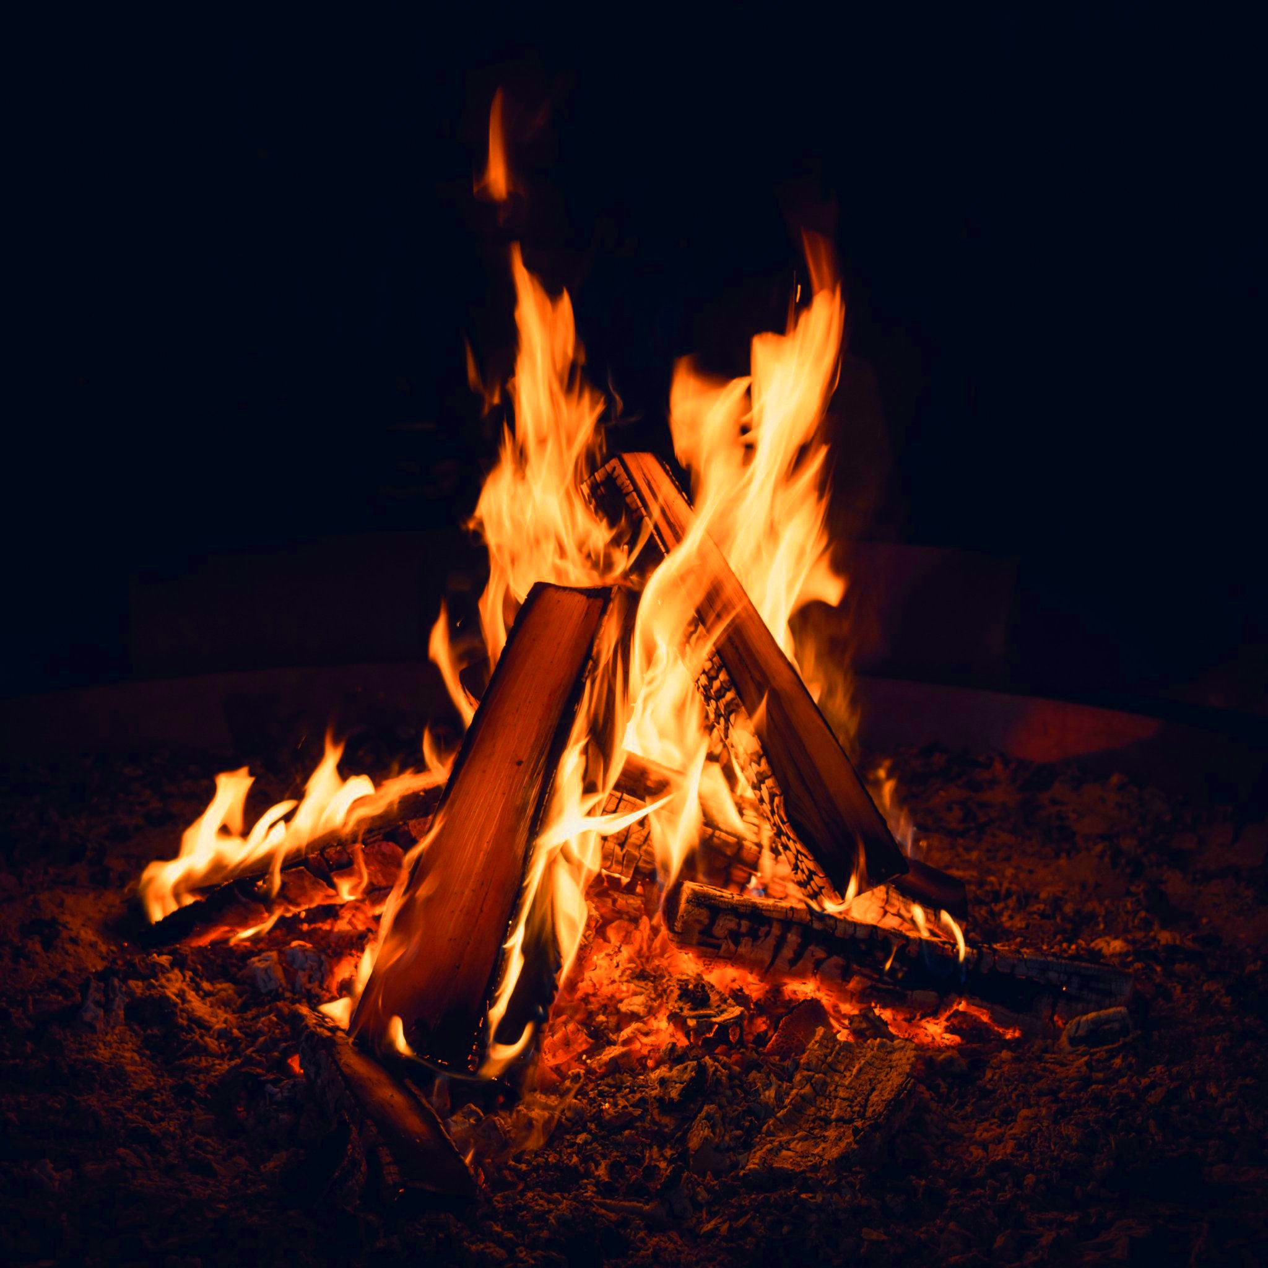
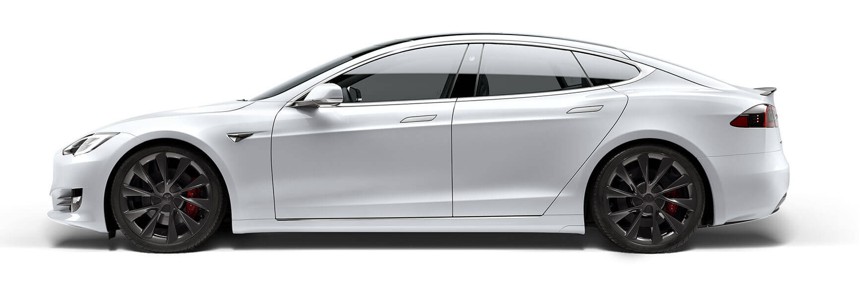
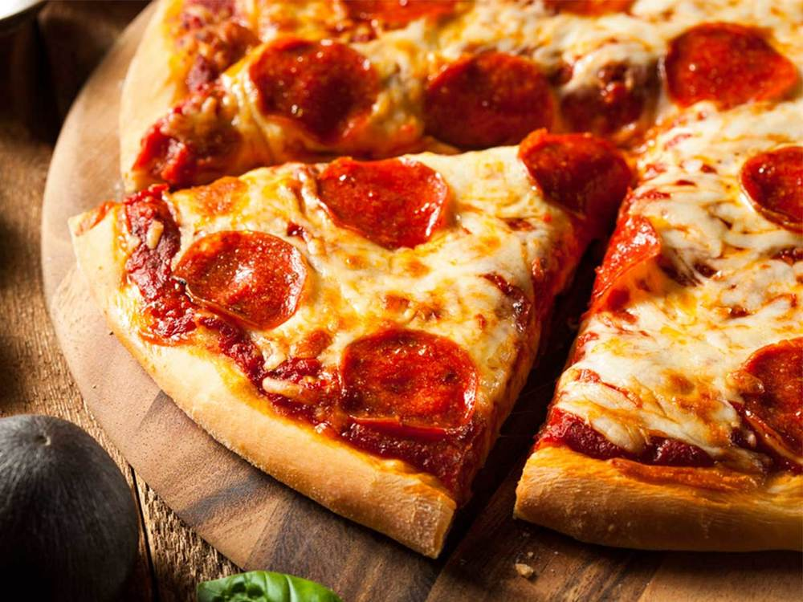
Energy Consumption
Entropy
Output
Waste heat:
2x10¹² W (3 TW)
Energy Input
Work Output
Economy
GDP and $$$
3x10¹² W (3 TW)
~10,000W per person!
1x10¹² W (3 TW)

Slide 11
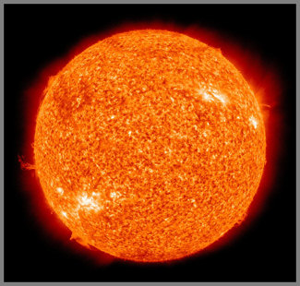
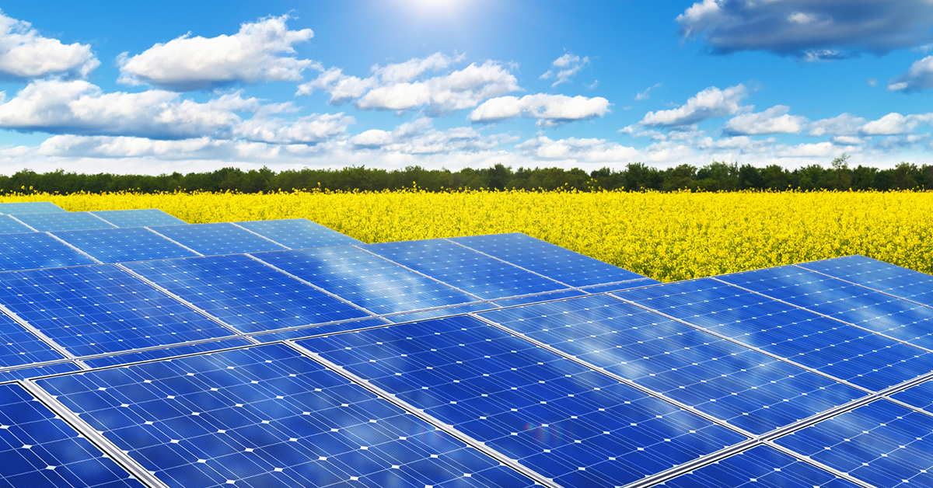
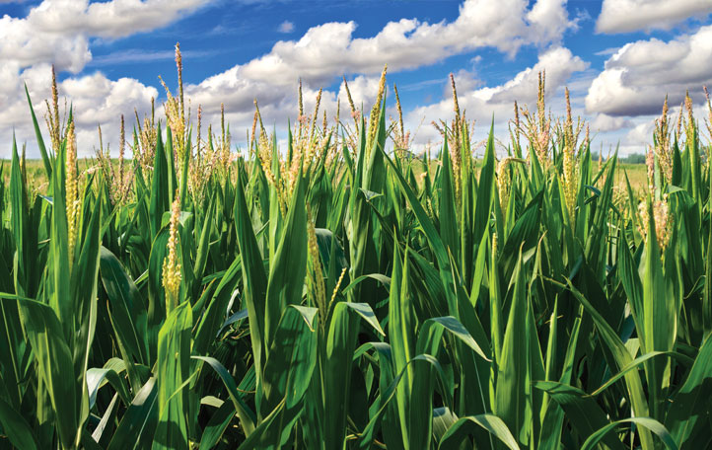
A6 and A7 - Solar Panels
173 Million GigaWatts of power are incident on planet earth!
10,000 times more than total human consumption.

Slide 12
A7 – Solar Microgrid

Slide 13
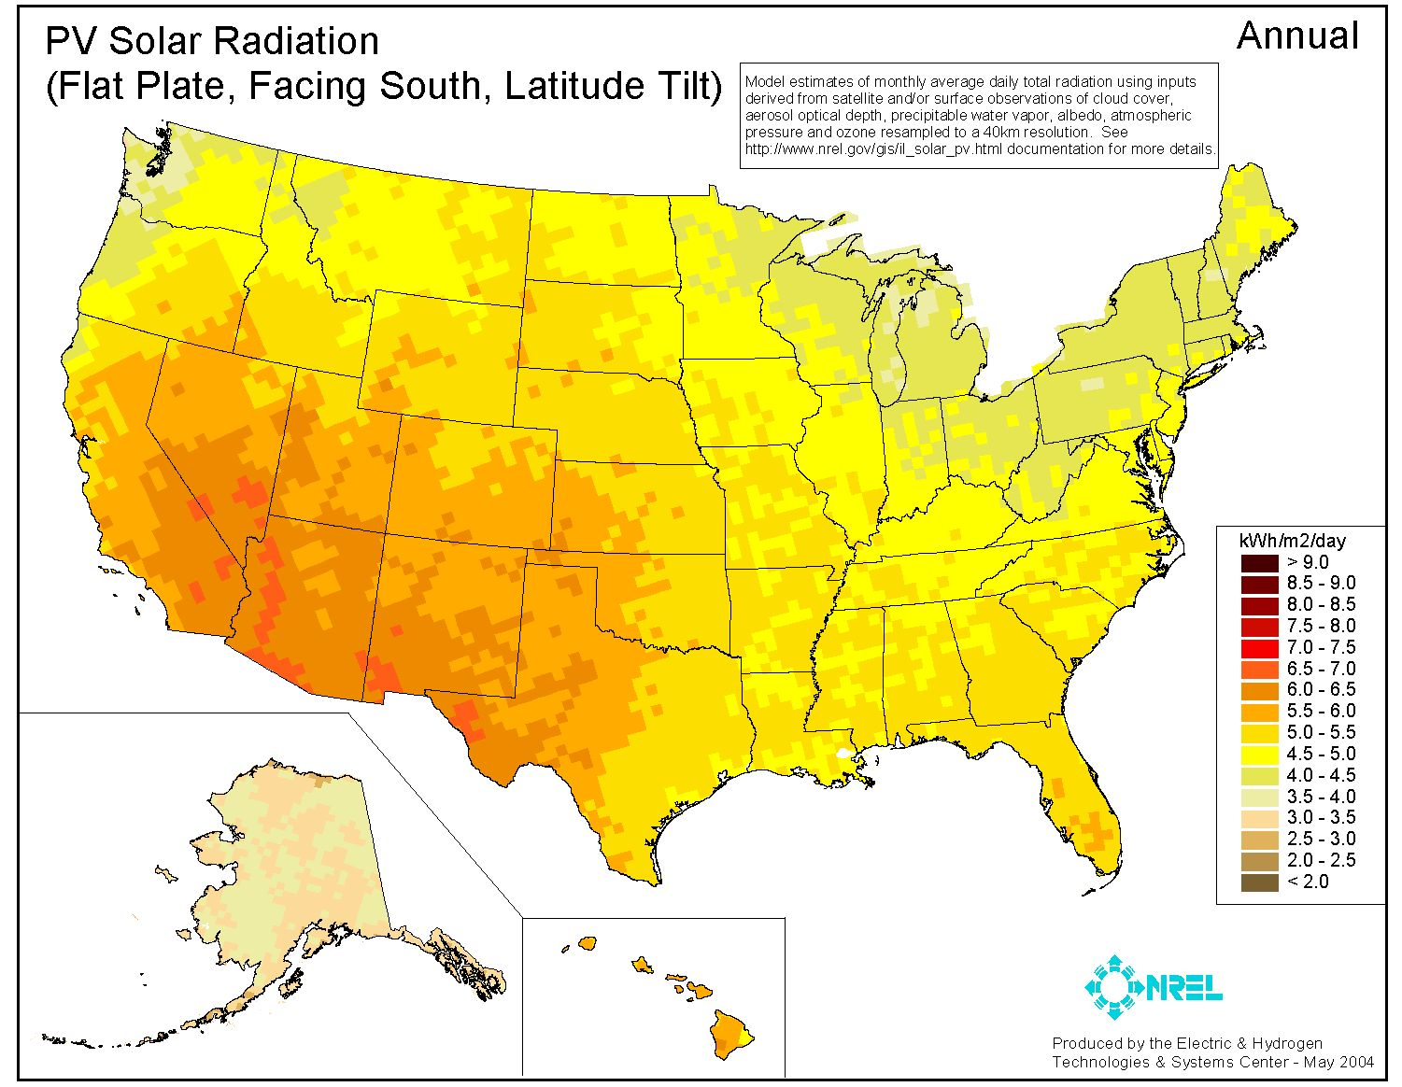

Slide 14
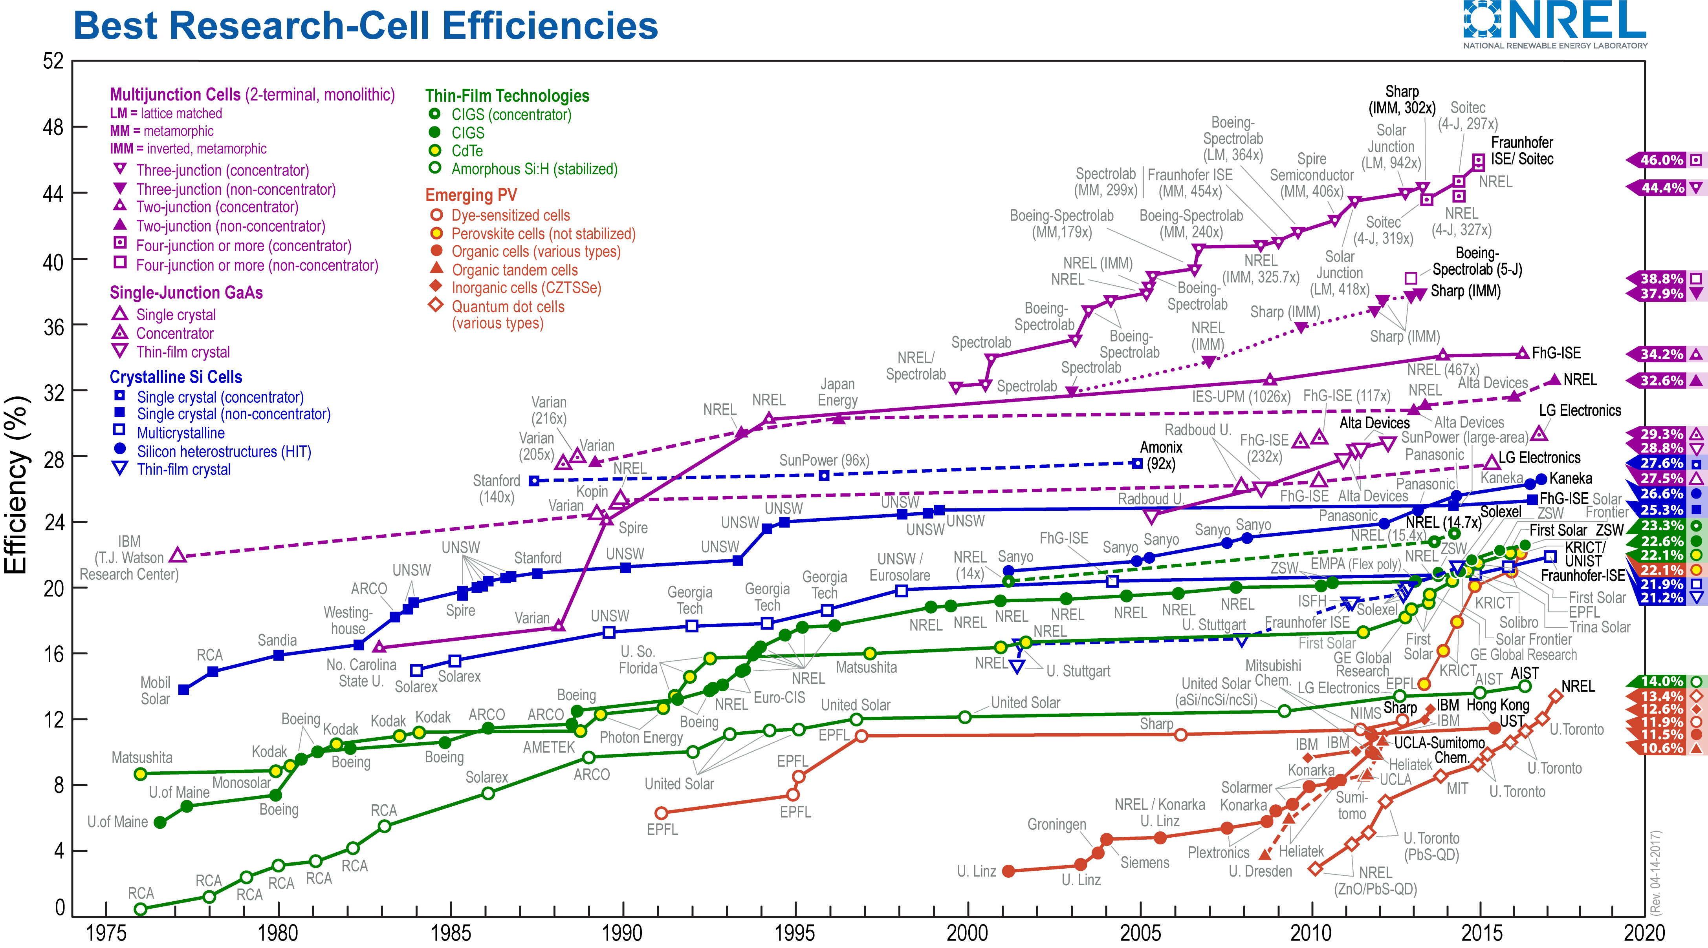
Solar Panel Efficiency
https://www.nrel.gov/pv/assets/images/efficiency-chart.png

Slide 15
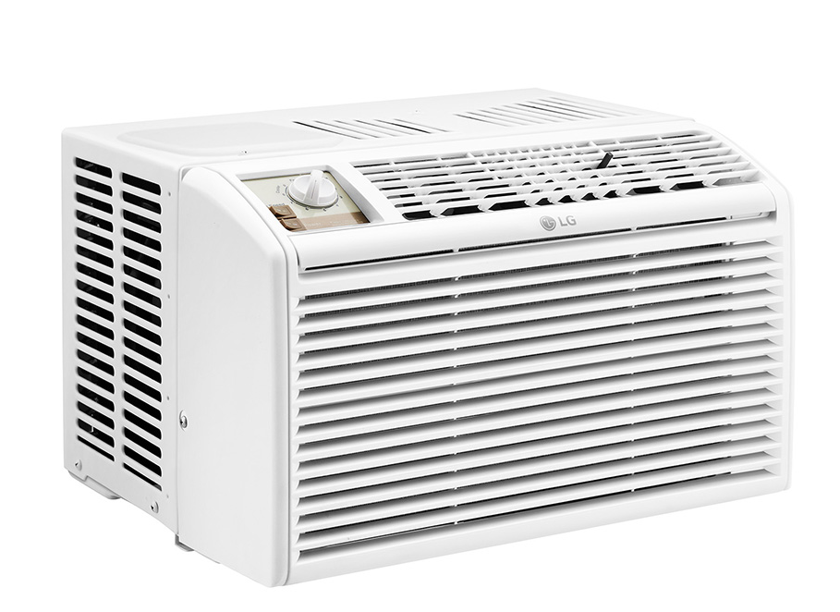
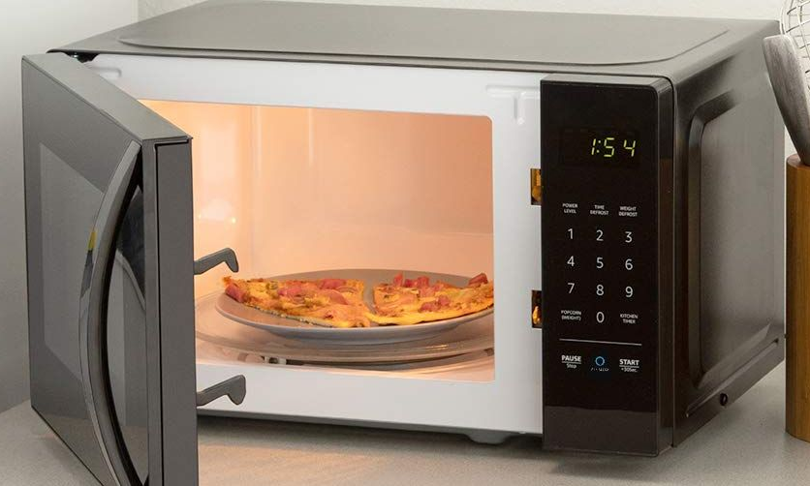
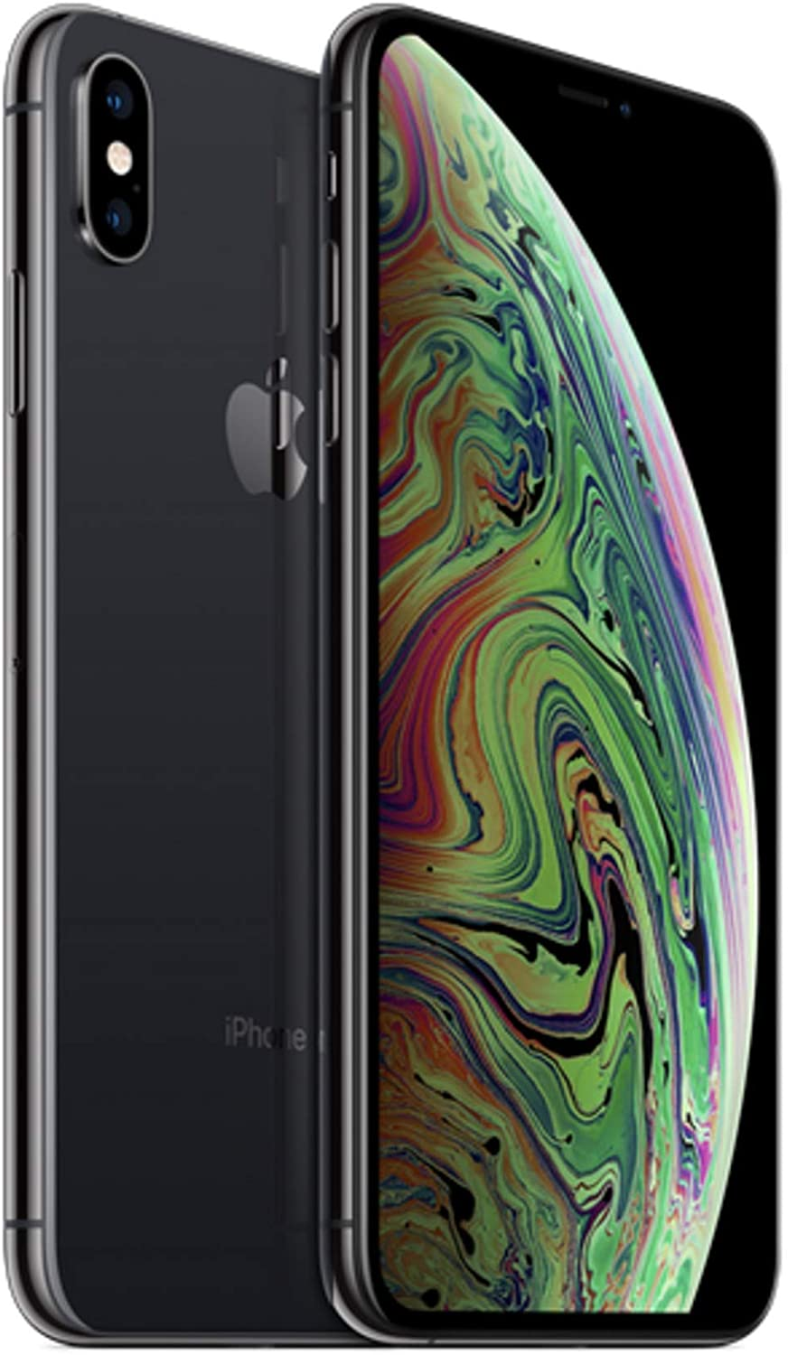
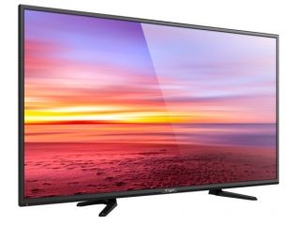
Appliances and Electronic Devices

Slide 16
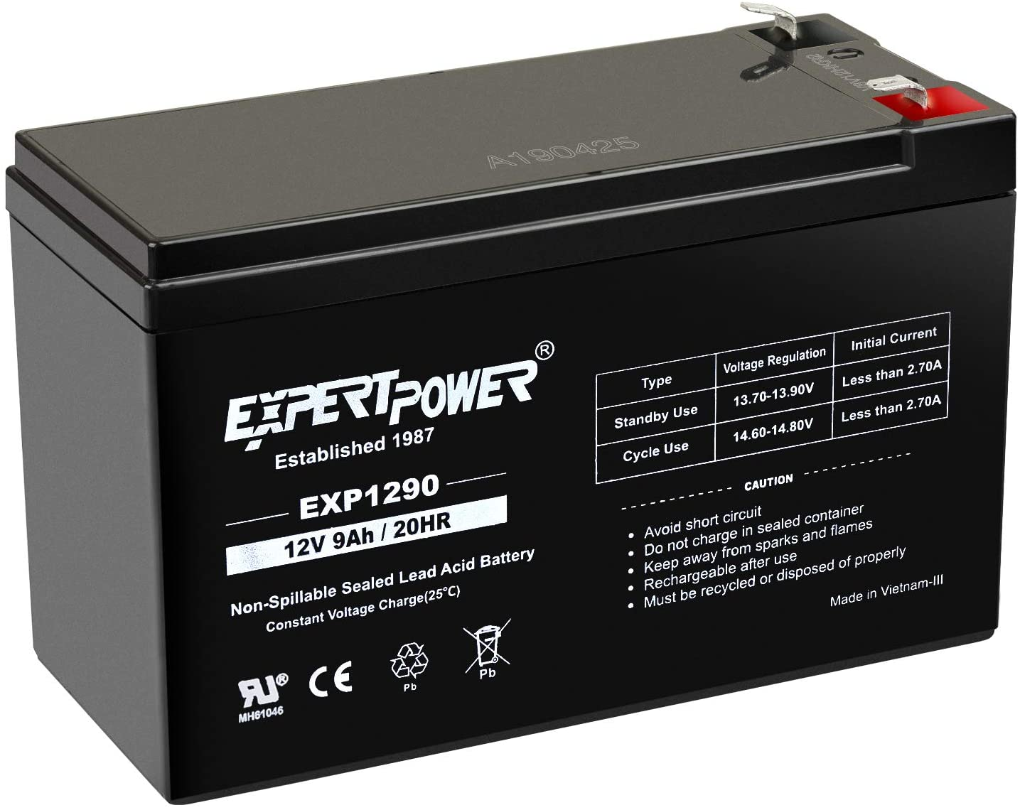
Batteries
Charge: “Amp-Hours” [Ah]

